Slide 1
Development of Private Capital Financing in Uganda’s Economy

Slide 2
Presentation outline
Background to private capital (equity & debt)
Case study – Pearl Capital Partners
Data and Trends in Africa, East Africa and Uganda
Key areas of reform required to develop private capital
Benefits
Conclusion

Slide 3
Background to Private Equity & Debt
Provision of debt or equity to private companies outside the banking system
Medium to Long Term (7-10 years) financing provided through private capital or venture capital funds
Most are registered in Mauritius or Luxembourg because of the tax advantages these countries provide, as well as enabling registration environment
Only one private equity fund manager licensed by Capital Markets Authority in Uganda (Pearl Capital Partners – managers of the Yield Fund, in which NSSF, European Union, and others have invested)

Slide 4
Case Study - Pearl Capital Partners
Investors
AGRA, Bill & Melinda Gates Foundation, Gatsby Foundation, JP Morgan, USAID, Volksvermogen and Rockefeller Foundation, European Union/IFAD, NSSF, SEDF, FCAI
Fund Manager
Pearl Capital Partners
50 Agribusiness Investees
Including Biyinzika Poultry, FICA Seeds, KK Foods, Clarke Farm, Naseco, Sekajja Agro Farms, PURA and others in the region
FUNDS
1. African Agricultural Capital – AAC 2006, $9 m, 16 investees in EA region, 14 fully divested
2. African Seed Investment Fund – ASIF 2010, $12 m, 13 investees in EA/SA region, divesting
3. African Agricultural Capital Fund – AACF 2011, $25 m, 8 investees in EA region, divesting
($1.5 m BDS Facility funded by USAID)
4. Yield Uganda Investment Fund – Yield
2017, €20.4 m, 13 investments made in Uganda
(€3 m BDS Facility funded by EU)

Slide 5
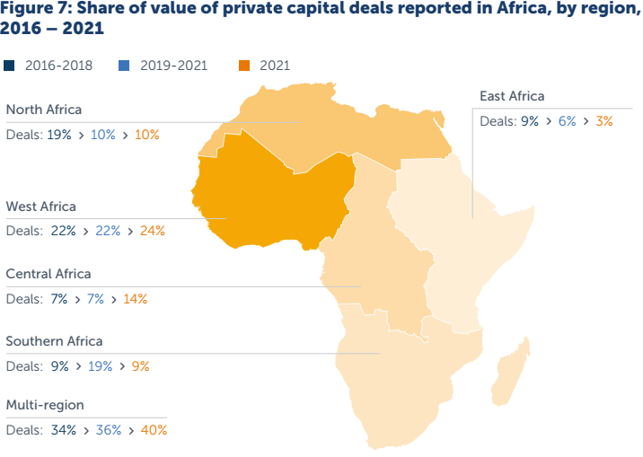
Data and Trends in Africa, East Africa & Uganda
2016 – 2021
Private capital action per annum
US$ 4.5b
Africa
US$ 492m
East Africa
US$ 123m
Uganda
Uganda
Investments made without considering oil and gas investments amount to c. US$ 50m per annum

Slide 6
Key enabling areas for implementation & reform
Gazette registration framework for private capital funds – work in progress with Uganda Registration Services Bureau
Taxation framework – for duly registered funds. Proposal is to
Eliminate withholding tax. Registered private capital funds (equity & debt) should pay 0% withholding tax
Reduce the capital gains tax from the present 30%. Kenya presently has this at 5%
Mobilization of long-term domestic savings. Retirement benefit funds need to play an active role in deploying their savings to finance the private sector. Proposal is to:
Reduce early access for the 65 company sponsored occupational schemes. Recent law in Kenya restricted early access to 50% of occupational scheme savings
Eliminate lump sum payments to all contractual retirement savers (NSSF and the 65 company sponsored schemes) with savings above 3,000 currency points, on retirement (Ghana, Zambia, Tanzania do not pay lump sums). This threshold is considered too low to commute to a monthly pension.
This will resolve the legal recognition of private capital funds under the Partnership Act 2010

Slide 7
Benefits of implementing proposed reform areas
Increased mobilization of domestic savings
Jobs realized from domestic management of investments and from investments made
Increased mobilization of foreign savings to complement domestic savings. Boosting availability of hard currencies, reducing costs of reserve currency management.
Government through UDC can establish a Private Equity Fund as per S.28 of UDC Act that seeks to establish an Industrial and Economic Development Fund (IEDF). A good registration & taxation regime will crowd in additional funding into the IEDF (i.e., 3x or 4x what GOU invests)

Slide 8
Conclusion
While efforts to establish a private capital industry are important and essential for additional private sector funding, the factors that ease doing business in Uganda must remain on the agenda of Government i.e.
Enforcement of contracts
Speedy resolution of court matters
Efficiency of the public sector in a) issuing licenses for construction, exports, b) land registration, c) cross border trade, d) enforcement of standards
Obtaining cheaper electricity for industries
Special focus on all forms of rural infrastructure to attract investment and industry

